Slide 1
Smart Solutions For Railways Based On IoT

Slide 2
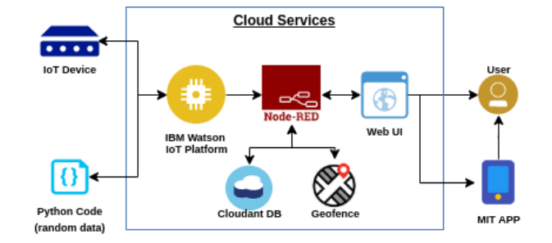
Work Flow of the project

Slide 3
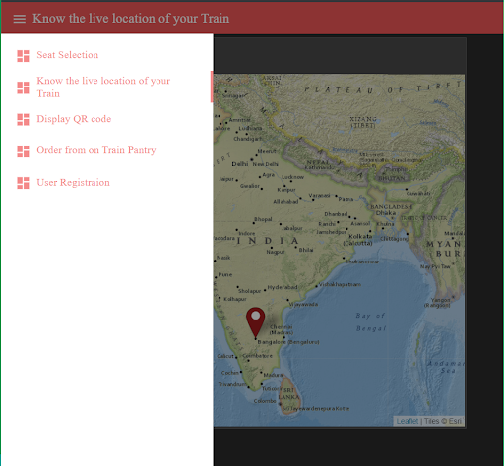
Web app Interface
Interface contains options like user registration, Display QR code, tracking, order from pantry etc.

Slide 4
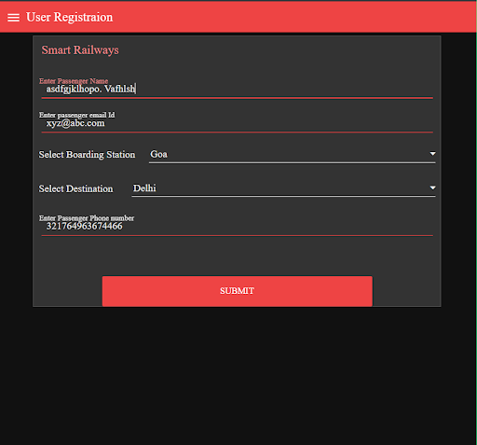
User Registration
User can register a booking by providing information like mail, mobile number, boarding and destination stations.
These details are converted into sting format using node red flows

Slide 5
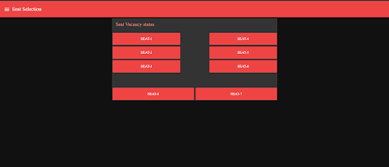
Seat Selection
User can select any seat they want, by seeing the remaining slots.

Slide 6
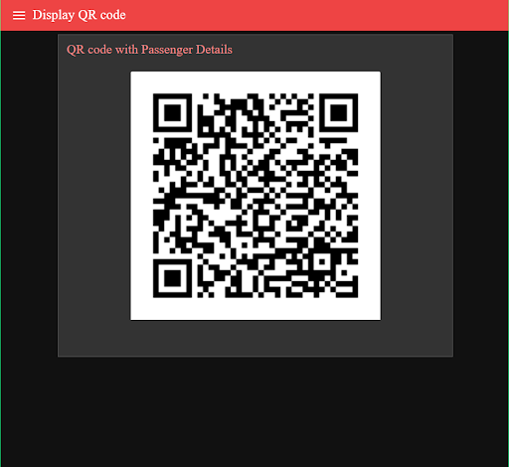
Generating QR Code after registration
The user details are converted into string formats and using this string a QR code is generated after every registration.
This QR code is used to verify details of a passenger.

Slide 7
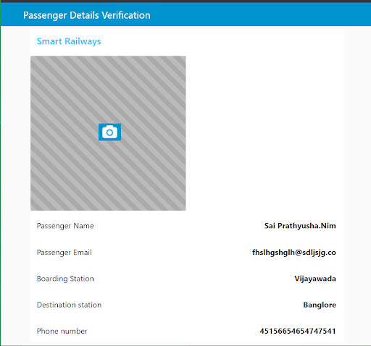
Verification of passenger details
Using a node red flow a scanner is created for scanning QR code.
Details of passenger is verified by scanning QR code.

Slide 8
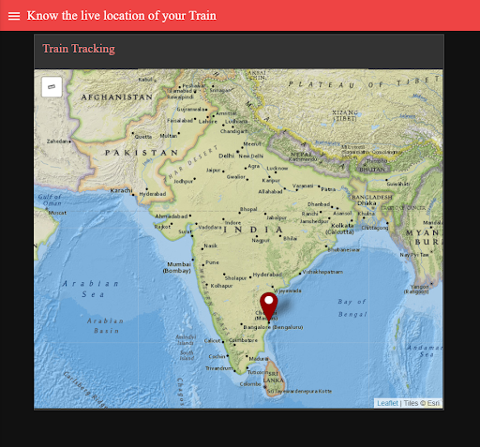
Live Location Tracking
Live location of train is tracked using geofence node.
Location of train is indicated by a red colour mark.

Slide 9
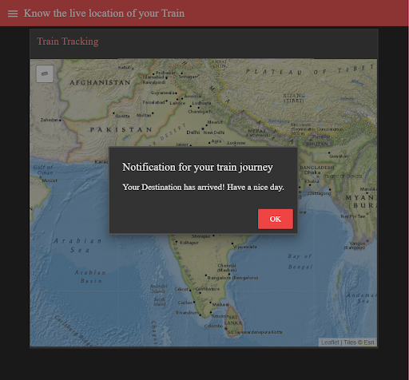
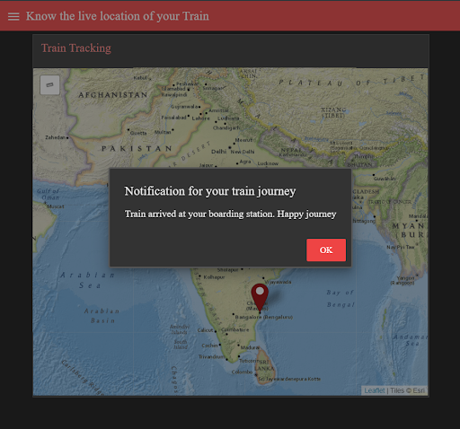
Real time notifications on train location
Both the arrival at boarding and destination stations are notified.

Slide 10
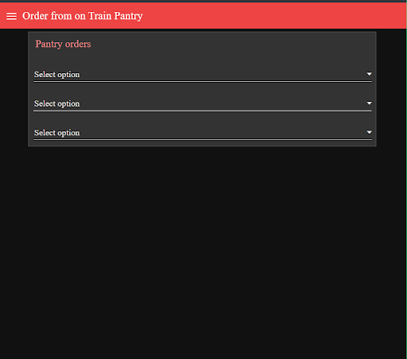
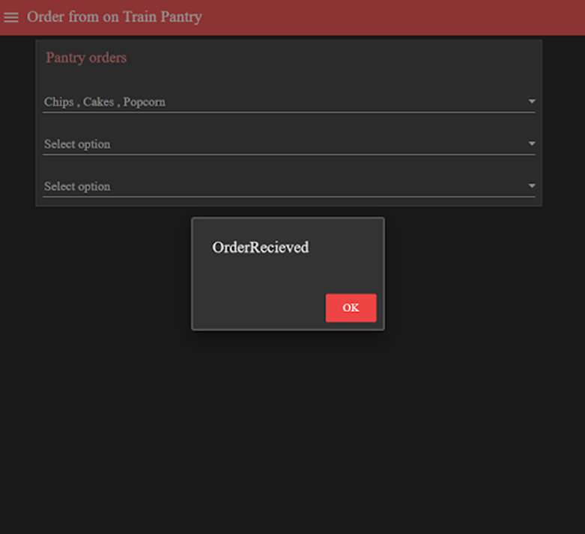
Order food from pantry
User/Passenger also can order pantry items using order from on train pantry option on the interface of node red web app.

Slide 11
Thank you!

